Slide 1



CCS in Vietnam
Potential of Unconventional Subsurface Storages
Tu Nguyen
MBA - Petroleum Engineer
Thang Doan
Principal Geoscientist
Binh Kieu
Sr. Geophysicist - Data scientist
Calgary Oct 10, 2024
Team: Ex2C

Slide 2
Agenda
The Urgency of CO2 Emission Mitigation in Vietnam
Building a Sustainable Future through CCS
Economic Framework & Financial Models
Data analysis & insight
Predictive model
Outcomes and Way forward

Slide 3
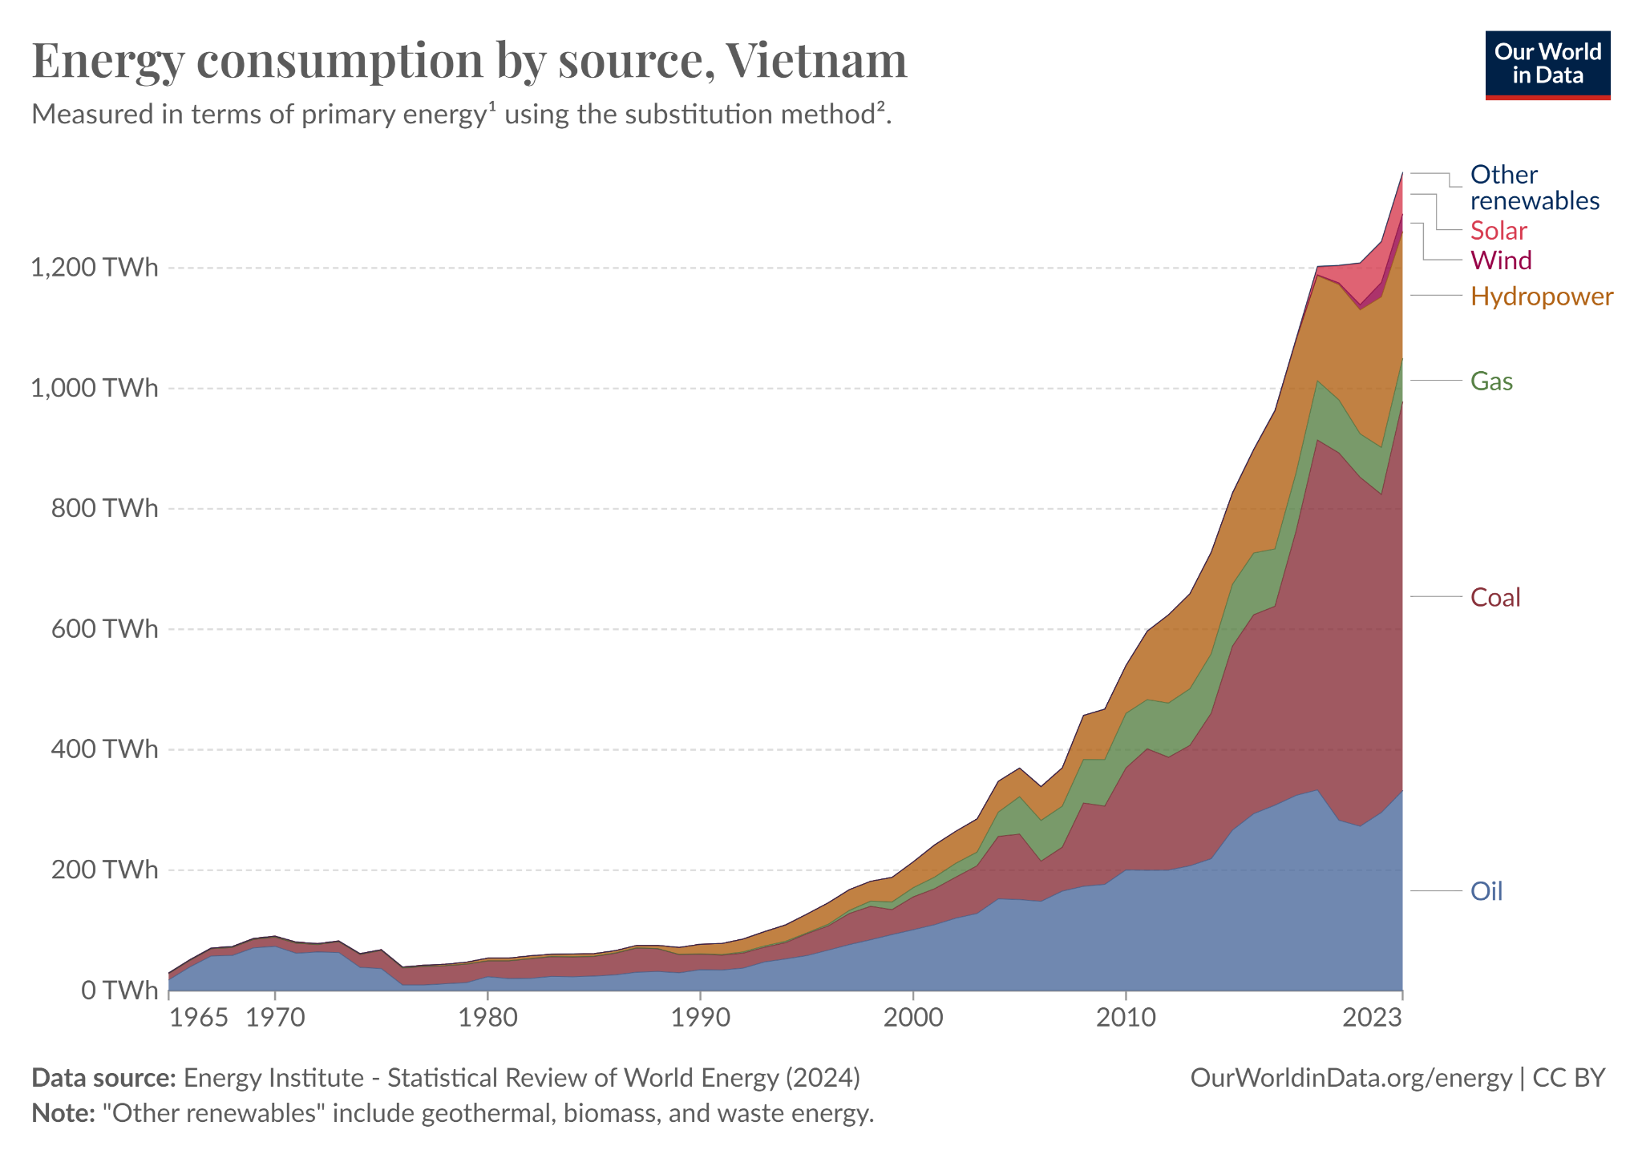
The Urgency of CO2 Emission Mitigation in Vietnam
Vietnam is among the top five countries most impacted by the global warming effect.
Vietnam is the most dynamic emerging economies with a rapid growth rate and in the most energetic economic development region, hence the high CO2 emissions.
Vietnam's typical fractured granite basement reservoir is a high-potential candidate for CO2 injection.
Vietnam has a significant capability of renewable energy (solar, wind) and is not far from CO2 source and subsurface storage
Vietnam would need to reduce its emissions to below 296 MtCO2e by 2030 and to below 248 MtCO2e by 2050 to be within its emissions allowances under a fair-share range compatible with global 1.5°C.
Notes:
The Global CCS Institute’s CCS Readiness Index (2018) [8] ranks Vietnam just above 70 percent for inherent interest meaning that it has a high fossil fuel dependency and therefore is likely to need CCS projects to meet future climate goals

Slide 4
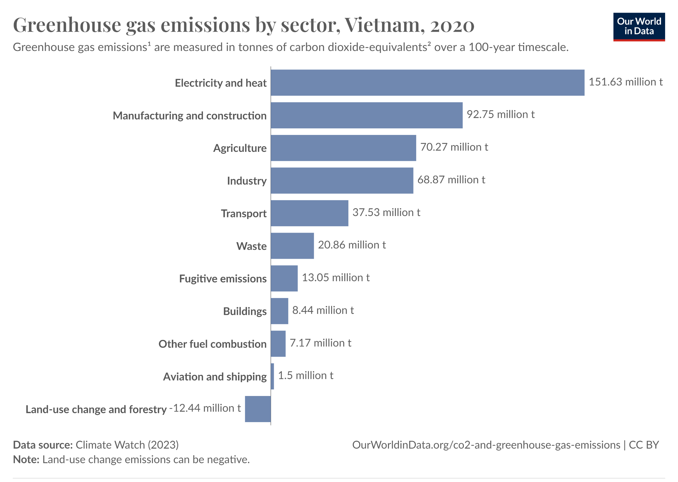
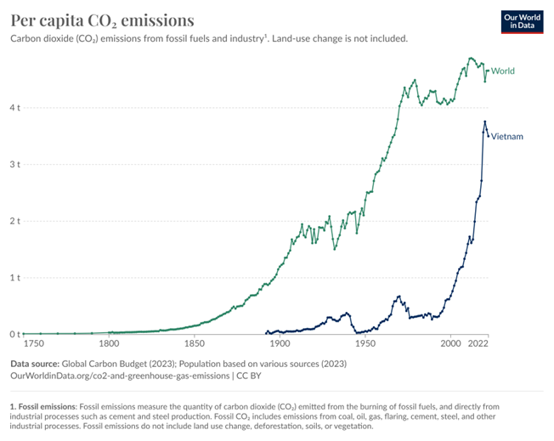
Understand the Current CCS Landscape in Vietnam
Energy Mix and Emissions
Notes:
https://ourworldindata.org/energy/country/vietnam#what-sources-does-the-country-get-its-energy-from

Slide 5
Recent Development
Building a Sustainable Future through CCS
Vietnam updated its Nationally Determined Contribution (NDC) in 2022, unconditionally pledging a 15% reduction in GHG emissions below business-as-usual (BAU) by 2030, while the Conditional Contribution rose from 27% to 43.5%. | The Power Development Plan 8 (PDP8) outlines an additional 20 GW of mostly onshore wind power by 2030. Planned solar capacity amounts to just 2.6 GW by 2030. | Fossil fuels (coal) a gradual phase-out of coal by 2050. Existing coal power plants will either be decommissioned or transitioned to cleaner fuel sources like hydrogen or ammonia. No new coal power plants are planned beyond those currently under construction​. | Natural gas remains a core part of the energy mix, with 30 GW of LNG (Liquefied Natural Gas) projects planned to come online by 2030.

Slide 6
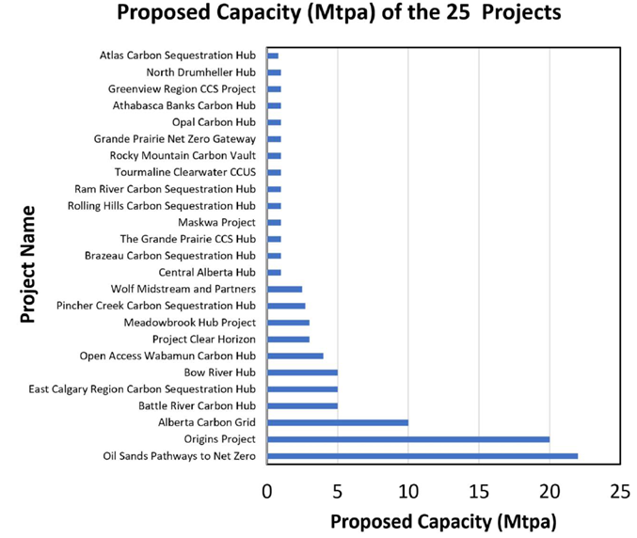
Building a Sustainable Future through CCS
CCS Potential - Vietnam
Alberta project (2022)
9 sites in the country are saline aquifers .
19 sites sitting in the Petroleum: 12 depleted fields in the Cuu Long basin 02 in the Nam Con Son basin
Depleted Oil field CO2 size: 355Mt - 10Mt (CL basin, NCS basin)
Research field: 43.2Mt CO2, about 2.16Mtpa in 20 year life long
Reference: https://www.ogci.com/wp-content/uploads/2023/12/CSRC_Cycle_3_Appendix_B_Asia.pdf
Notes:
https://www.epa.gov/energy/greenhouse-gases-equivalencies-calculator-calculations-and-references#:~:text=1%2C540.1%20lbs%20CO2/MWh%20%C3%97%201%20metric%20ton/2%2C204.6,also%20available%20on%20the%20AVERT%20web%20page.
West Texas San Andres dolomite water alternating gas (WAG) CO2 flood performance data were used to derive P10, P50, and P90 CO2 storage efficiency factors of 0.76, 1.28, and 1.74 Mscf/STB (stock tank barrel) of original oil in place. Median CO2 storage efficiency factors from continuous CO2 injection following conventional waterflood varied from 15% to 61% and 8% to 40% for fluvial clastic and shallow shelf carbonate simulation models, respectively, while those from WAG injection varied from 14% to 42% and 8% to 31%, respectively. Variation in the CO2 storage efficiency factors was largely attributable to reservoir depth (a surrogate for reservoir pressure and temperature) and lithology (clastic versus carbonate).

Slide 7
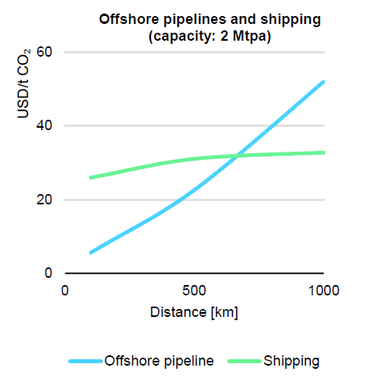
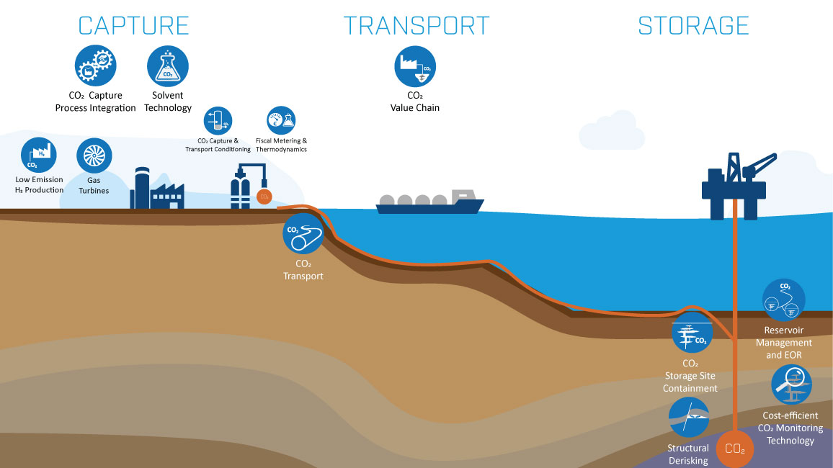
Economic Framework: Cost, Viability & Risk Analysis
Cost Analysis of CCS Chain
Economic Viability & Revenue Streams
Risk and Feasibility Assessment
150km
Notes:
Pipeline capacity is the leading factor influencing cost.
Costs decrease from USD 9-11/t CO2 for a 3 Mt CO2/yr
pipeline down to USD 2-3/t CO2 for a 30 Mt CO2/yr
pipeline over 250 km distance.
Other factors impacting transport costs include:
• Distance
• Mode of transport (e.g. pipeline, ship, truck, barge)
• Transport condition of CO2
• Topology

Slide 8
Vietnam Financial Model - Pipeline selection
Model Data
Pipeline CAPEX and OPEX
Material cost
Labour construction cost
Miscellaneous cost
Pipeline Design
Operational pressure
Design pressure
Outer diameter
Thickness
Compression and Pumping
CAPEX
OPEX
Energy consumption
Project management cost
Owner’s cost
Contingency cost
Electricity price
Exchange rates
Inflation rates
Corporate tax rate
Depreciation rates
Pipeline Financial Model Inputs
Real discount rate (%)
Volume (Mtpa)
Commercial operations date (COD)
Cessation of injection (COI)
Utilization rate (hours)
Internal rate of return
Pipeline distance
Model Calculations
CAPEX and OPEX distribution over economic over economic lifetime
Midy-year PV of CAPEX, OPEX and volumes stored
CAPEX depreciation
Unlevered free cash flow
Key Model Inputs
Cost breakdown
Levelized unit pipeline cost (USD)
Pipeline tariff at 10% IRR (USD/tCO2)
Reference: VEGARD MOEN (9132), The Economics of Carbon Capture and Storage, University of Stavanger Business School (2023)
Notes:
Summary of pipeline component in the financial model. Pipeline, compression and pumping CAPEX and OPEX and pipeline design is based on Knoope et al. (2014) and on industry consultations.Levelised unit pipeline cost is the sum of discounted annual CAPEX and OPEX divided by the sum of discounted annual volumes transported.
Pipeline capacity is the leading factor influencing cost.
Costs decrease from USD 9-11/t CO2 for a 3 Mt CO2/yr
pipeline down to USD 2-3/t CO2 for a 30 Mt CO2/yr
pipeline over 250 km distance.
Other factors impacting transport costs include:
• Distance
• Mode of transport (e.g. pipeline, ship, truck, barge)
• Transport condition of CO2
• Topology

Slide 9
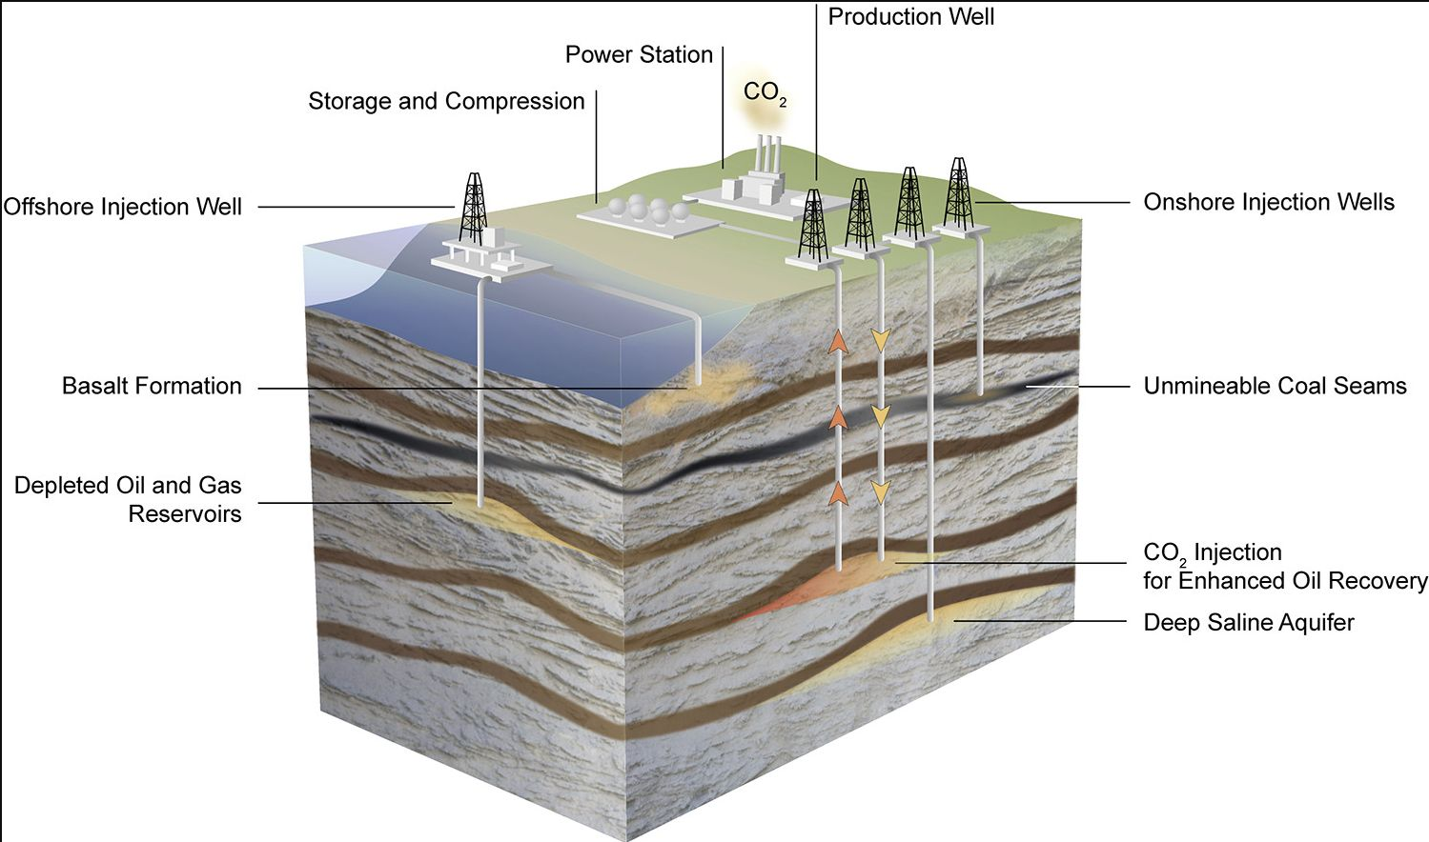
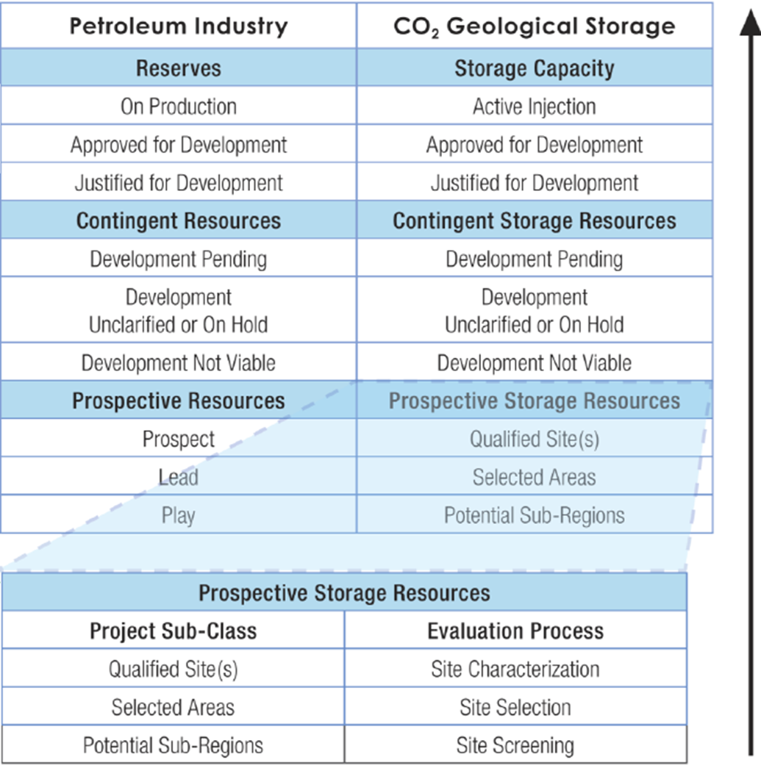
Data analysis & insight
CCUS - Major tasks
Identification of potential storage site
Determination of sequestration capacity
Preparation & Injection
Post-injection monitoring
https://www.netl.doe.gov/sites/default/files/2018-10/BPM-SiteScreening.pdf
‹#›

Slide 10
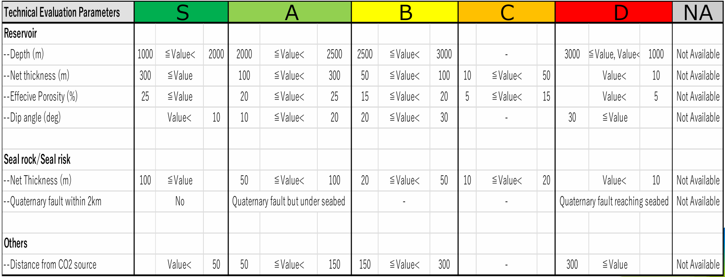
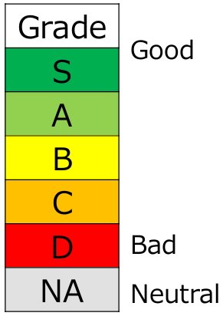
Data analysis & insight
Site selection criteria
Source: VPI
Five Subsurface Requirement:
Have a SEAL ROCK to prevent vertical flow to the ground surface
Be DEEP enough (>800 m) to keep CO2 in a supercritical state, which allows for storage of more CO2
Have a LARGE STORAGE VOLUME to store significant qualities of CO2
Be leak-free (any FAULT/FRACTURE ZONES and other zones of weaknesses in the storage formation or present wells/boreholes which might trigger CO2 leakage)
Have a reasonably large PERMEABILITY, which allows for the injection of CO2 at reasonable rates from a reasonable number of wells.

Slide 11
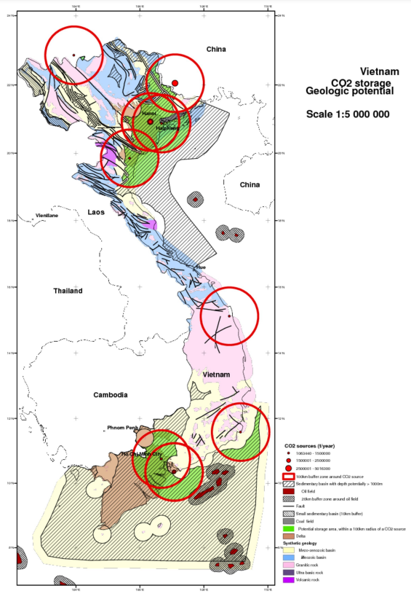
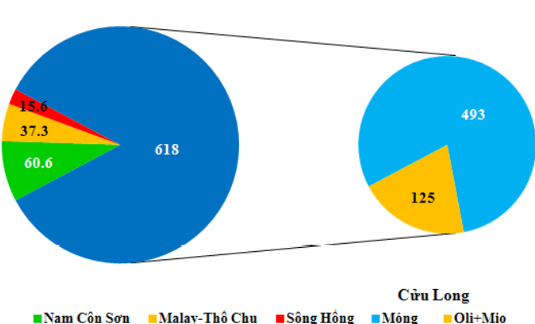
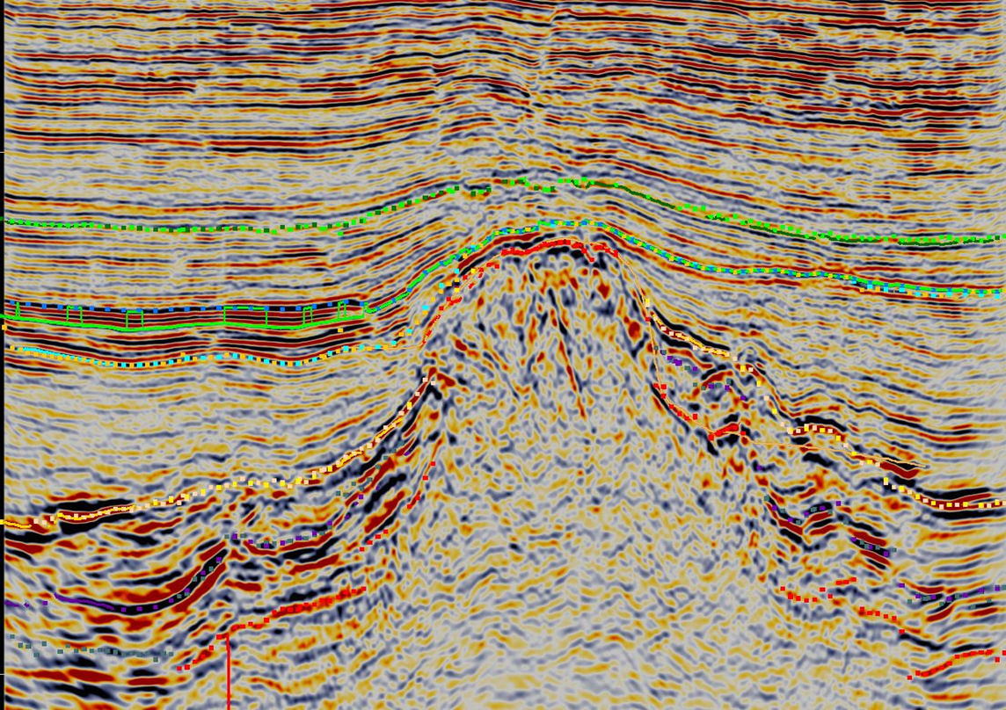
Data analysis & insight
Vietnam Oil & Gas and CCUS overview
Geological formations potentially favorable for CO2 storage in Vietnam.
Source: BRGM/TKV (2009, p. 34).
Hydrocarbon reserve (731.5M m3) among basins.
Proportion of fractured basement reservoir (80%) vs Oli-Mio reservoirs in Cuu Long basin.
Most of fields are more than 20 years production.
Song Hong Basin
Source: Petro Explorers Inc.
VN Geology & Petroleum resources – 2019 edition, PVN
Cuu Long Basin
Nam Con Son Basin
9 sites in the country are saline aquifers .
19 sites sitting in the Petroleum: 12 depleted fields in the Cuu Long basin 02 in the Nam Con Son basin
Malay-Tho Chu Basin
Notes:
https://www.ogci.com/wp-content/uploads/2023/12/CSRC_Cycle_3_Appendix_B_Asia.pdf
https://www.sciencedirect.com/science/article/abs/pii/S1875510020300627

Slide 12
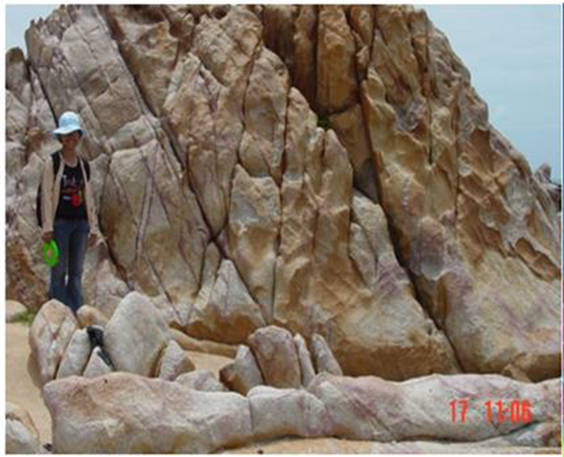
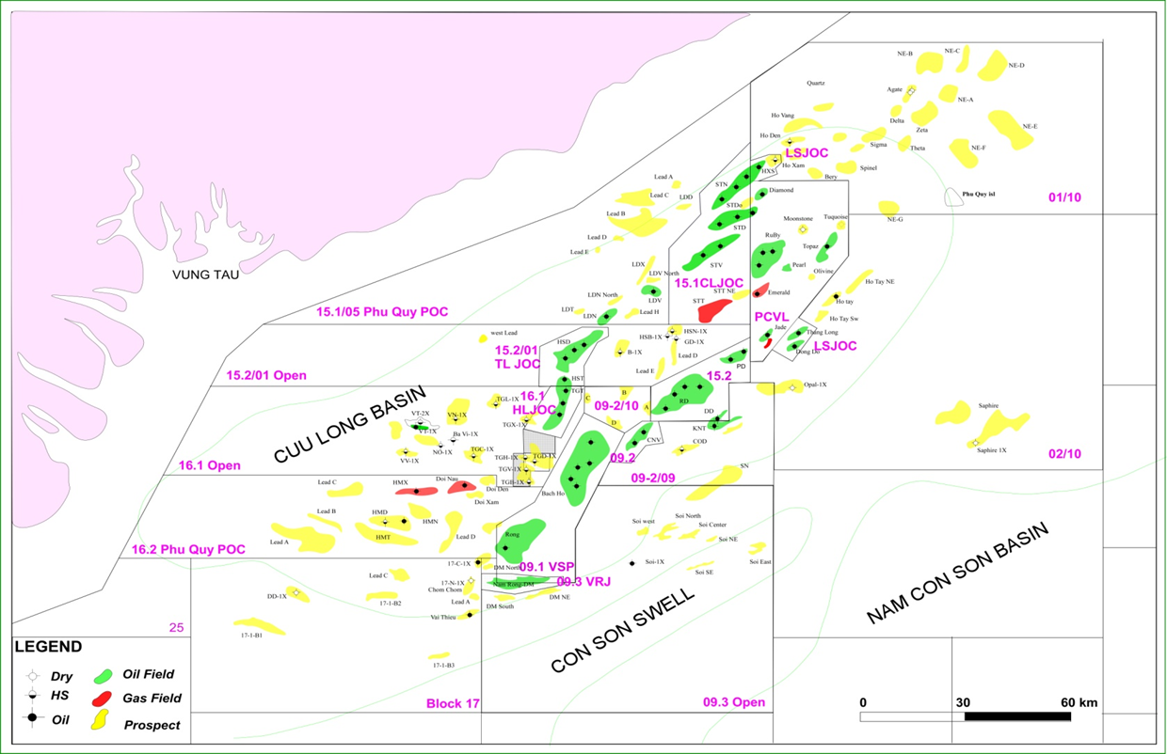
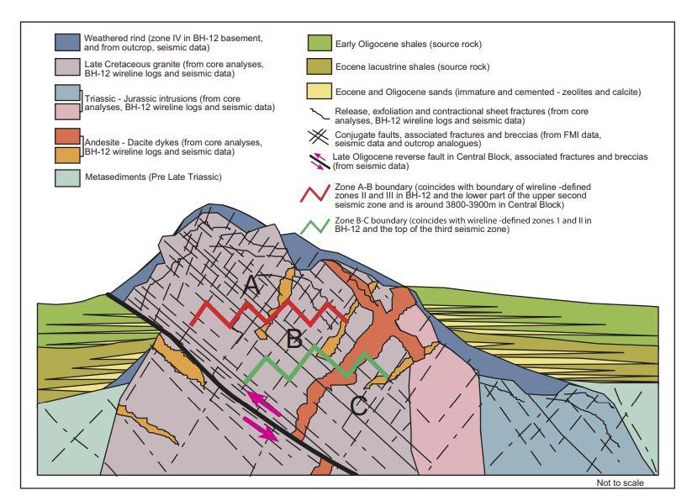
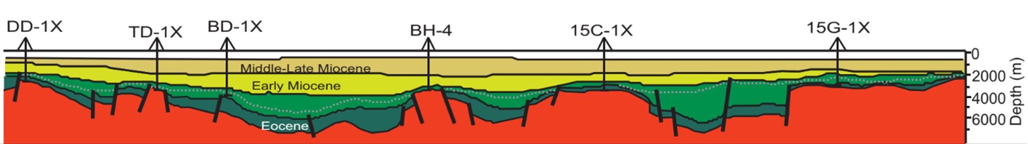
Data analysis & insight
Fractured reservoir overview
Fractured basement: High perm (upto Dm), solid rock frame, proven seal
43.2Mt CO2, about 2.16Mtpa in 20 year life long
Source: PVEP
B
A
A
B
Trinh Xuan Cuong* and J. K. Warren**
Notes:
Accumulate production volume (189mil tons oil/500mil tons hiip)
Dau kt + nuoc kt - nuoc inject = a
Ef = a/(Dau kt + nuoc kt )

Slide 13
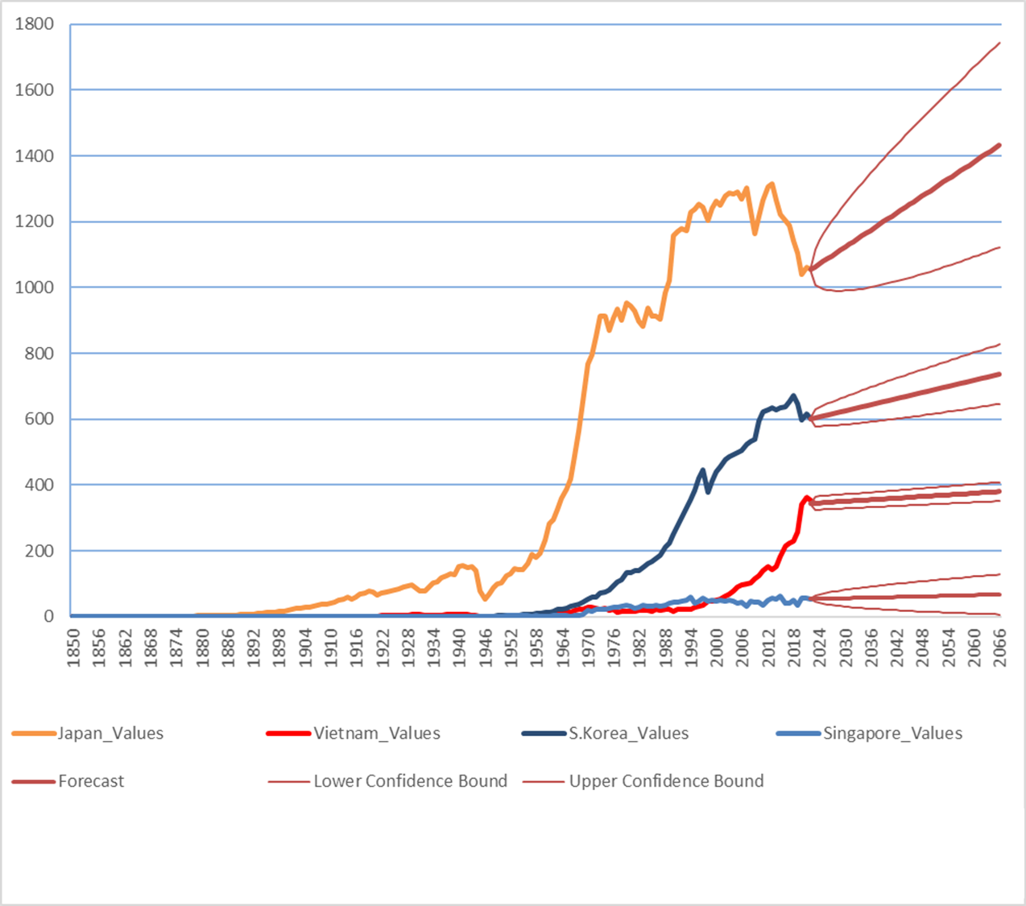
Predictive Model
CO2 Emissions to 2050 - A Pathway to Reduction
Mt
Exponential Triple Smoothing (ETS) model predicting on time series data:
Non-linear data
Predict future sales, inventory, or consumer trends
2050 prediction: L:341.30, F:366.5396 U:391.78. Increase trend
2050 target is below 248Mt, 118.5Mt negative carbon
366.5
248
Year

Slide 14
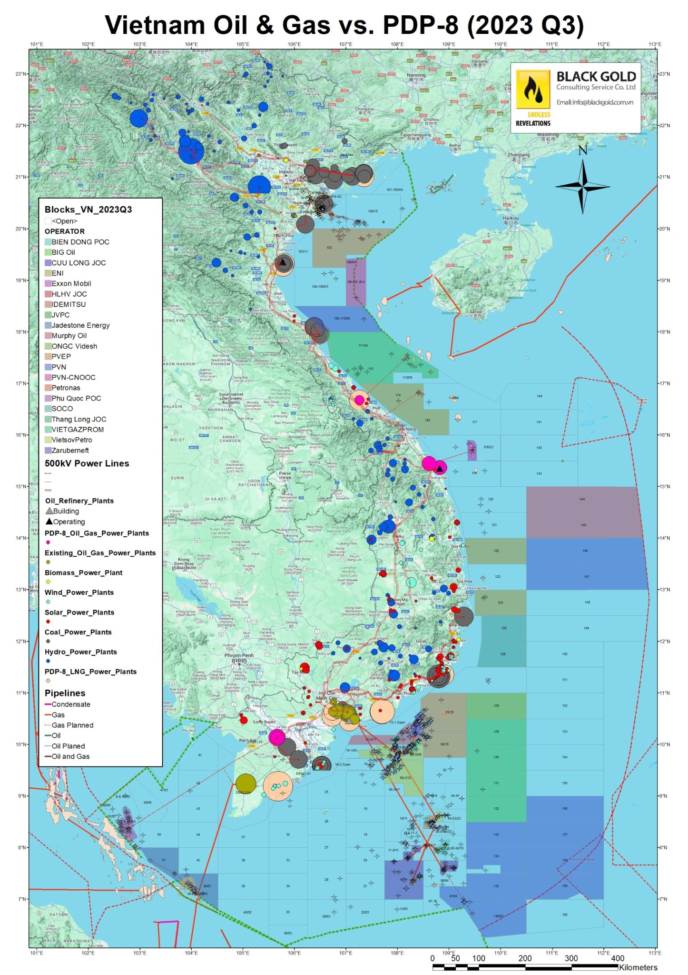
Outcomes & The Path Forward
Potential of unconventional storage for CCS
Granite Reservoir Models: Given Vietnam’s unique geology, further research and modeling of fractured granite reservoirs will provide critical insights into their long-term viability and storage capacity for CO2 sequestration.
Financial Models for CCS: Robust financial models that account for CAPEX, OPEX, and potential revenue streams are essential.
These models will guide stakeholders in making informed investment decisions, ensuring economic viability across the CCS chain. Regulatory considerations will follow as part of the next stage of this work.
Notes:
These models will guide stakeholders in making informed investment decisions, ensuring economic viability across the CCS chain. Regulatory considerations will follow as part of the next stage of this work.

Slide 15
Ex2C
Thank You

